Slide 1


hi
everyone

Slide 2
Introduction
Data structures are fundamental to the field of computer science, serving as a key building block in developing logical thinking and problem-solving abilities. A solid grasp of data structures not only strengthens understanding of core concepts but also equips students with the tools necessary to design optimal software solutions. Mastery of this subject is essential for creating efficient, high-performing systems.
At its core, the study of data structures involves the management and organization of data through structures like arrays, linked lists, stacks, queues, trees, and graphs. These structures form the backbone of many algorithms and play a critical role in enhancing the performance and efficiency of computer programs. Selecting the right data structure can significantly impact the effectiveness of a solution.
In this paper, we will go beyond the theoretical aspects of data structures and delve into their practical application in a real-world project: a score entry system. This system relies on efficient data management to process and store information, and choosing the appropriate data structures is crucial for ensuring its optimal performance. We will explore how the proper selection and implementation of data structures can solve practical problems and improve overall system efficiency.
By combining theory with hands-on application, this report aims to provide readers with a comprehensive understanding of data structures and their practical uses. The ultimate goal is to enable the application of this knowledge to software projects, thereby contributing to the development of more robust and efficient technological solutions.

Slide 3
Body
1.1 Definition of Stack Data Structure
A Stack is an abstract data structure that operates on the LIFO (Last In, First Out) principle, meaning the last element added is the first one to be removed. The stack has two main operations:
Push: Adds an element to the top of the stack.
Pop: Removes and returns the element from the top of the stack.
Additionally, there are other operations such as:
Peek/Top: Accesses the top element without removing it.
IsEmpty: Checks whether the stack is empty.
Examples of Stack in Real-World Problems
Managing Recursive Functions (Recursion): When a recursive function is called, information about the current function state (local variables, return pointers, etc.) is stored in a Stack. Once the recursion finishes, this information is popped from the stack to resume execution.
Bracket Matching: A Stack is used to verify the validity of bracket sequences in expressions (parentheses, square brackets, curly braces). When encountering an opening bracket, it is pushed onto the stack; for a closing bracket, the stack is checked for a corresponding opening bracket. If no match is found, the sequence is invalid.
Undo/Redo in Software: Undo and redo functionalities in text editors, graphic software, or code editors often use a stack to store system states at various points. Pressing “undo” pops the most recent state from the stack to revert to the previous one.
Tree Traversal: In in-order, pre-order, or post-order tree traversal algorithms, a stack can be used to keep track of the nodes that have not been processed.
Converting Infix Expressions to Postfix: In arithmetic expression evaluation, a stack is used to store operators when converting expressions from infix notation to postfix or prefix notation.
Function Call System in CPUs: During execution, the CPU uses a stack to store return addresses for function calls, allowing it to return to the correct address after a function completes.
The stack is a simple yet powerful structure, widely applied in many real-world problems.

Slide 4
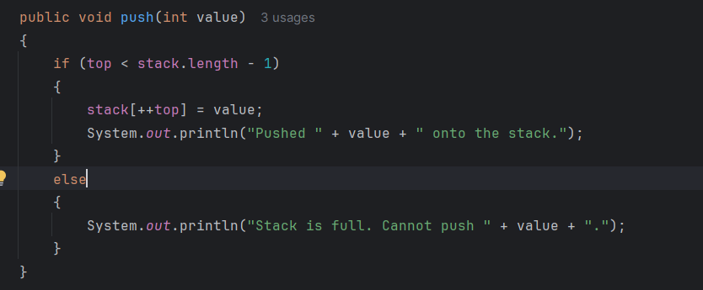

Slide 5
The push operation adds an element to the top of the stack. In the provided code, the push method performs the following:
Check for Full Stack: It first checks if the stack is full by comparing the current top index with the maximum capacity of the stack (stack.length - 1). If top is less than this value, there is space available for a new element.
Add Element: If there is space, the method increments the top index (using top++) and assigns the value to the position in the array at the new top index.
Output Message: A message is printed indicating that the value has been successfully pushed onto the stack.
Handle Full Stack: If the stack is full, it prints a message indicating that the push operation cannot be performed.

Slide 6
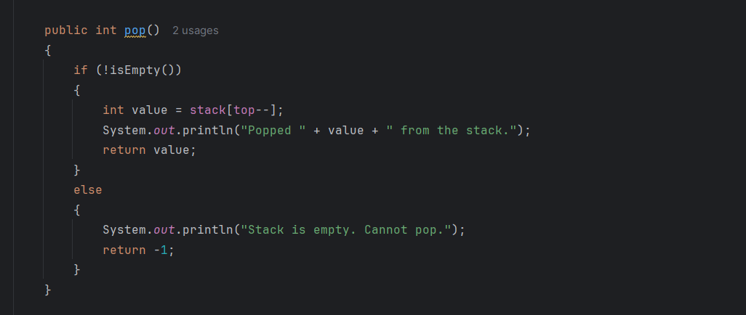

Slide 7
The pop operation removes the top element from the stack and returns its value. Here’s how the pop method works:
Check for Empty Stack: It first checks if the stack is empty by calling the isEmpty() method. If the stack is not empty, it proceeds to pop the element.
Retrieve Element: The method retrieves the value at the current top index and then decrements the top index (using top--) to remove that element from the stack.
Output Message: A message is printed indicating that the value has been popped from the stack.
Return Value: The value that was popped is returned.
Handle Empty Stack: If the stack is empty, it prints a message indicating that the pop operation cannot be performed and returns -1 to signify that there was no element to pop.

Slide 8
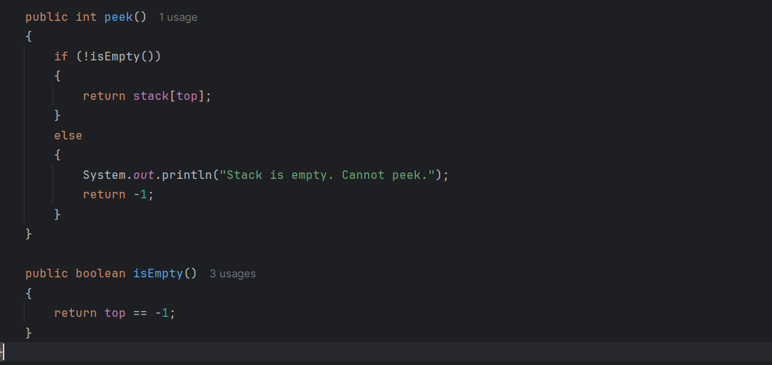

Slide 9
The peek operation allows you to view the top element of the stack without removing it. The peek method works as follows:
Check for Empty Stack: Similar to the pop operation, it first checks if the stack is empty by calling isEmpty().
Return Top Element: If the stack is not empty, it simply returns the value at the top index without modifying the stack.
Output Message: If the stack is empty, it prints a message indicating that peeking is not possible and returns -1.

Slide 10
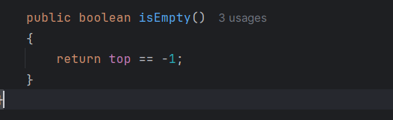

Slide 11
The isEmpty operation checks whether the stack is currently empty. The isEmpty method is quite straightforward:
Check Top Index: It compares the top index with -1. The stack is considered empty if top is -1, which indicates that no elements have been pushed onto the stack yet.
Return Boolean Value: The method returns true if the stack is empty (i.e., top == -1), and false otherwise.

Slide 12
2.1. Encapsulation.
2.1.1. What is encapsulations.
In object-oriented programming (OOP), encapsulation is one of the fundamental principles, where data and the methods (functions) that operate on that data are bundled together within an object. Encapsulation helps restrict direct access to the data from outside the object and allows manipulation of the data only through the methods provided.
Specifically:
Data Hiding: The attributes of an object are usually declared as private or protected, preventing other parts of the program from directly accessing them. Instead, users of the object must use getter or setter methods to retrieve or modify the values of the attributes.
Protecting Data Integrity: By allowing changes to the values only through specific methods, the programmer can control how and under what conditions the data can be modified. This ensures that the data remains valid and that the object is always in a consistent state.
Improved Maintainability: Encapsulation makes code easier to maintain because the implementation details are hidden, and changes to how an object works do not affect other parts of the program, as long as the object's public interface remains the same.

Slide 13
2.1.3. Data Protection.
Encapsulation for Data Hiding
Private Variables: In the Student class, key attributes such as id, name, marks, and rank are designated as private. This design choice ensures that these attributes are not accessible directly from outside the class, embodying the essence of encapsulation—data hiding.
Controlled Access via Public Methods: To facilitate controlled access to the private variables, the class includes public getter methods. For example, methods like getId(), getName(), and getMarks() allow users to retrieve data as needed while preventing unrestricted access to the underlying attributes:

Slide 14
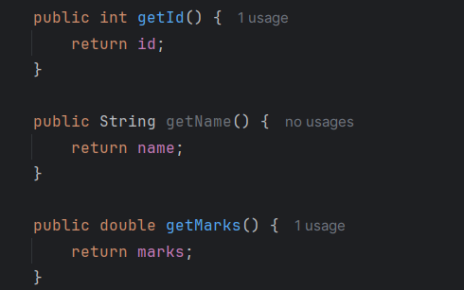

Slide 15
Maintaining Data Integrity
The Student class employs internal logic to uphold the integrity of the data. For instance, the setMarks(double marks) method not only updates the marks but also recalculates the student’s rank in response to the new marks. This design ensures that any changes made to one attribute are reflected in related attributes, thus averting inconsistencies in the data:

Slide 16
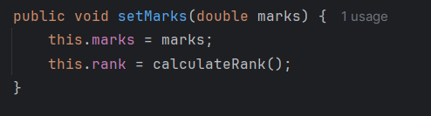
The calculateRank() method is kept private, ensuring that only the internal mechanisms of the class can dictate how a student’s rank is determined.

Slide 17
Secure Data Management in StudentManager:
The StudentManager class serves as the interface for handling Student objects, allowing operations such as adding, editing, deleting, and sorting students. This management is performed through secure, predefined methods, thereby safeguarding the underlying student data.
For example, when modifying or deleting a student’s details, the method locates the student by ID using a private method called findStudentById(), which ensures that only valid student records are accessed:

Slide 18
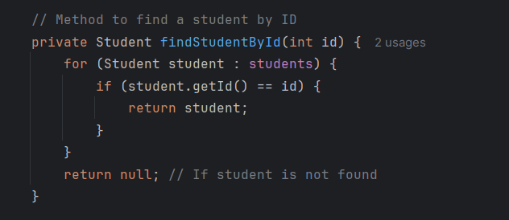

Slide 19
2.1.4. Modularity and Maintainability.
Modularity
Modularity is a design philosophy that involves breaking down a larger system into smaller, manageable, and self-contained components, known as modules. In this program, modularity is accomplished by organizing the code into distinct classes and methods, each assigned specific responsibilities.
Class Separation:
The program is structured around two primary classes: Student and StudentManager, each fulfilling different roles.
The Student class focuses on representing student data by encapsulating attributes such as id, name, marks, and rank.
The StudentManager class is tasked with managing business logic, including operations for adding, editing, deleting, displaying, and sorting students. This separation of concerns simplifies understanding and managing the code.
Method-Based Modular Design:
Within the StudentManager class, methods like addStudent(), editStudent(), deleteStudent(), displayStudents(), and sortStudentsByMarks() are designed to perform specific tasks. This modular approach avoids lengthy, convoluted code blocks by encapsulating each functionality within its own method.
The private method findStudentById() is modular, allowing the search logic for students to be reused throughout the class whenever an ID-based lookup is required.
This design not only promotes clarity but also facilitates future enhancements; for instance, if there’s a need for a feature like searching by name, it can be added without disrupting the existing code structure.

Slide 20
Maintainability
Maintainability refers to the ease with which a system can be updated or modified over time. This program incorporates several practices that enhance future maintainability:
Encapsulation:
By using private variables (like id, name, marks, and rank) in the Student class, the internal state of each student is safeguarded. Data can only be accessed or modified through public getter and setter methods, ensuring that internal changes (such as adjustments in rank calculation) can be implemented without affecting other parts of the program.
Single Responsibility Principle:
Each method is crafted to handle a specific task, making the code easier to debug, modify, and extend. For instance, if a bug arises in the student addition process, you only need to focus on the addStudent() method.
Adjustments to the logic in one method will not disrupt other areas of the system, minimizing the risk of introducing bugs during updates.
Extensibility:
The code is organized to facilitate the straightforward addition of new features. For example, if you wish to include more attributes in the Student class (like age or class), only minimal changes to the existing methods in StudentManager would be required.
Similarly, introducing new functionalities, such as filtering students by rank, can be accomplished by adding new methods to StudentManager without altering the fundamental data model in the Student class.
Ease of Testing
Modular Methods: Since each method is designed to perform a distinct action (like adding or editing a student), writing unit tests for individual methods becomes more straightforward. For example, you can specifically test the addStudent() method to confirm its functionality or validate that the sortStudentsByMarks() method accurately sorts students in descending order by marks.
Reduced Complexity: By dividing the logic into small, manageable units, the code's complexity decreases, making it easier to test for accuracy. Bugs can be isolated more effectively because they are confined to smaller sections of the codebase.
Separation of Concerns
The program adheres to the principle of separation of concerns, wherein data management (handled by the Student class) is distinct from business logic (managed by the StudentManager class).
This division ensures that any modifications in how student data is processed (like changes to attributes or calculation methods) do not impact the functionality of student management operations and vice versa. This enhances both the modularity and maintainability of the program.

Slide 21
2.1.5. Code Reusability.
1. Encapsulation and Reusability of the Student Class
The Student class encapsulates the core properties (such as id, name, marks, and rank) along with methods pertinent to a student. This design enhances the class's reusability across various contexts:
Encapsulated Attributes: The use of private fields combined with public getter and setter methods allows the Student class to remain flexible. These methods control access to student data, enabling adaptation for various applications, like grading systems or any student-related software.
Rank Calculation Logic: The calculateRank() method is kept private and internal to the class, making it a self-contained feature. Any modifications to how ranks are determined can be made within this method, ensuring that other parts of the program remain unaffected. This encapsulation allows the class to be reused in different applications that require basic student information and ranking based on marks.
2. Reusability in the StudentManager Class
The StudentManager class oversees a collection of Student objects, designed with reusability in mind through the following strategies:
Modular Methods: Functions like addStudent(), editStudent(), deleteStudent(), displayStudents(), and sortStudentsByMarks() are modular, each performing a specific task. This design allows these methods to be reused across various contexts requiring student management, such as different educational systems, or they could even be extended for managing other types of data.
Utilization of ArrayList<Student>: By using a generic ArrayList<Student> for student management, the class gains reusability across various operations like sorting and searching. This choice also offers the flexibility to adapt to other data structures in the future with minimal adjustments to core methods.
3. Separation of Concerns
The code achieves a separation of concerns by dividing the logic into two distinct classes: Student, which manages individual student data, and StudentManager, which handles student management functions. This separation enhances reusability:
Extensibility of StudentManager: The StudentManager class can be easily extended to incorporate additional functionalities without altering the Student class. For instance, methods like findStudentByName() or filterStudentsByRank() could be added, further promoting reusability in more intricate systems.
Scalability: This separation ensures the program can scale and be reused in various applications, such as employee management or customer relationship management, simply by adjusting the Student class to fit new data models.

Slide 22
4. Generic and Flexible Logic
Sorting Logic: The sortStudentsByMarks() method employs Collections.sort() alongside a Comparator to arrange students by their marks in descending order. This approach is versatile and can be easily modified to accommodate other sorting criteria (such as sorting by name or rank) by altering the comparator logic. The flexibility inherent in this sorting mechanism allows for reuse in any application that necessitates sorting objects based on specific attributes.
5. Potential for Reuse in Other Contexts
The design of this program allows for considerable reuse beyond the realm of student management:
Applicability in Other Domains: The StudentManager class can find utility in other fields, like employee or product management, where similar operations (add, edit, delete, display, sort) are commonplace. By simply renaming Student to Employee or Product and adjusting a few attributes, the existing logic remains applicable in diverse contexts.
Adaptation of Code: Given that the methods for adding, editing, and deleting data are encapsulated, they can be adapted with minimal changes for various object types (like employees, books, or items in a library system).
6. Maintaining Reusability Through Design
Minimized Code Duplication: The methods in both classes are structured to prevent code duplication, a crucial aspect of reusability. For example, instead of creating unique code to update a student’s rank after modifying their marks, the program utilizes the setMarks() method, which automatically recalculates the rank. This encapsulated behavior enhances reusability and mitigates the risk of errors that could arise from replicating such logic in multiple areas.
Find Student by ID: The findStudentById() method provides a reusable mechanism for locating a student, applicable whenever a student needs to be found (such as during editing or deletion). Furthermore, this method can be generalized or expanded in the future to search by other attributes.

Slide 23
2.2. Information Hiding
2.2.1. Abstraction.
Abstraction is a method of simplifying complex systems by concentrating on the fundamental features while concealing the intricate implementation details. In the realm of Abstract Data Types (ADTs), abstraction enables users to interact with data types through a clearly defined interface, eliminating the need to understand the underlying implementation. As a result, users can work with data structures like lists or stacks based on their functionalities rather than their internal mechanisms.
For instance, when utilizing a stack ADT, a programmer can perform operations like pushing or popping elements without needing to know if the stack is implemented using an array or a linked list. This separation of concerns not only streamlines usage but also provides the flexibility to modify implementations without impacting the user's code.

Slide 24
2.2.2. Reduced Complexity
By concealing implementation details, Abstract Data Types (ADTs) greatly minimize complexity for developers. Users interact with a streamlined interface that reveals only the essential operations, simplifying the understanding and utilization of the data structure. This simplification not only reduces the likelihood of errors but also makes debugging processes more manageable.
For example, when working with a queue ADT, developers can avoid dealing with the complexities of internal element storage and management. Instead, they can concentrate on enqueuing and dequeuing operations, which enhances development efficiency and promotes a clearer grasp of the program's logic.

Slide 25
2.2.3. Improved Security.
Information hiding enhances security by limiting access to sensitive data within an Abstract Data Type (ADT). By providing only essential methods and keeping data members private, ADTs guard against unauthorized access and modifications. This encapsulation maintains the integrity of the data and ensures that it can only be manipulated through well-defined interfaces.
For instance, consider a bank account ADT that facilitates deposits and withdrawals while concealing the balance from direct access. In this case, external code cannot modify the balance directly; it can only do so through specific methods that enforce certain rules, such as preventing overdrafts. This approach not only secures the data but also ensures that business logic is applied consistently throughout the application.

Slide 26
3.1. Encapsulation and Information Hiding
Encapsulation is a fundamental principle in both imperative Abstract Data Types (ADTs) and object-oriented programming (OOP). In imperative ADTs, data types are defined by specifying a collection of operations that interact with internal data, which remains hidden from external access. This setup ensures information hiding, as the internal state and implementation specifics of the data structure are not exposed to outside code.
In the context of object-oriented programming, encapsulation is realized through objects that combine both data (fields) and methods (operations on that data). Similar to imperative ADTs, the internal state of an object is often kept hidden using private or protected access modifiers, allowing external interactions only through clearly defined interfaces or methods. This method of encapsulation enables an object to retain control over its internal state, safeguarding it against unintended modifications from external sources.
The shift from imperative ADTs to OOP encapsulation is smooth, as both paradigms aim to conceal complexity and safeguard the integrity of internal data. OOP enhances the foundational concepts established by ADTs by introducing more sophisticated mechanisms for data hiding and access control.

Slide 27
3.2. Modularity and Reusability
In imperative Abstract Data Types (ADTs), modularity involves separating concerns by defining data types with their associated operations as a cohesive unit. This structure allows ADTs to be reused throughout different sections of a program without needing insight into their internal workings. Imperative ADTs provide a modular framework by emphasizing what an ADT accomplishes rather than how it achieves those goals, aligning well with reusability principles.
Object-oriented programming (OOP) further enhances modularity by structuring software around classes. Each class serves as a blueprint for creating objects, encapsulating both state and behavior. This design promotes greater reusability, as objects can be instantiated multiple times, and classes can be extended or inherited to introduce specialized behaviors while leveraging existing functionalities.
In OOP, features like inheritance and polymorphism significantly bolster reusability by enabling new objects to build upon existing ones and allowing objects to be treated uniformly through a shared interface. These capabilities extend the modularity and reusability of imperative ADTs, making classes and objects more adaptable than standalone ADTs. The capacity to reuse components via class hierarchies, interfaces, and composition in OOP illustrates how imperative ADTs paved the way for the modularity and reusability principles inherent in object-oriented programming.

Slide 28
3.3. Procedural Approach
The procedural aspect of imperative ADTs centers on defining a collection of operations or procedures that manipulate the internal data of the ADT. This approach is fundamental to imperative programming, where the sequence of operations determines the program's behavior. ADTs define procedures (methods or functions) that ensure operations are correct while providing an abstraction over the underlying data.
Object-oriented programming retains the procedural characteristics of operations but encapsulates them within objects. In OOP, methods fulfill a similar role to ADT operations, providing necessary actions to interact with an object's data. The key distinction is that, in OOP, methods belong to a class, and their behavior can vary depending on the state of the object they operate on, supporting more dynamic interactions.
Although OOP introduces concepts like inheritance and dynamic dispatch (polymorphism), the procedural aspect remains vital. Methods are still executed sequentially, with procedural logic guiding the interactions with an object's state. The procedural foundations of imperative ADTs thus serve as a precursor to the method-driven interactions found in OOP systems.
In summary, OOP builds on the procedural roots of imperative ADTs while introducing object-centric features such as method overriding and method overloading, facilitating more dynamic and flexible interactions.

Slide 29
3.4. Language Transition
The evolution from imperative ADTs to object-oriented programming can be observed in the progression of programming languages. Early languages like Pascal and C supported ADTs through modular programming and encapsulation features, allowing developers to create complex data types alongside their associated operations, effectively modeling ADTs. However, the integration of data and behavior into a unified entity wasn’t fully realized until object-oriented languages like Smalltalk, C++, and Java emerged.
In these object-oriented languages:
C++ introduced classes, inheritance, and polymorphism while maintaining compatibility with the procedural paradigm of C, marking a clear evolution from ADTs to full-fledged object orientation.
Java advanced this model by enforcing encapsulation, supporting inheritance hierarchies, and embedding polymorphism into the language's design framework.
The transition from imperative ADTs to object-oriented classes is a natural evolution. ADTs lay the groundwork for defining how data and operations should be structured, while OOP builds upon this by incorporating principles such as inheritance, dynamic dispatch, and polymorphism.
This transition signifies a shift from static, procedure-driven approaches to more dynamic, object-oriented paradigms where entities possess both state and behavior. The encapsulation and operational structures of ADTs set the stage for the development of objects and classes, which have become foundational to modern object-oriented languages.

Slide 30
Conclusion
In summary, a critical aspect of software engineering involves the analysis of abstract data types (ADTs) and their integration into system development. By delving into the intricacies of ADTs—from their formal definitions to operational specifications and actual implementations—developers gain a deeper understanding of data structures and algorithms. This knowledge forms the foundation for building robust and efficient software systems.
Additionally, comparing various sorting algorithms, such as Merge Sort and Quick Sort, provides valuable insights into computational complexity and algorithmic performance. These analyses are vital for making informed decisions when designing algorithms that need to scale efficiently for real-world applications.
Moreover, examining encapsulation and information hiding highlights the importance of maintaining data integrity and promoting code modularity. Adhering to these core principles is essential for developing software systems that are easy to understand, update, and extend over time. By encapsulating data and behavior within well-defined modules and concealing internal implementation details, developers can effectively manage complexity and minimize the risk of unintended interactions among system components.
Furthermore, studying network shortest path algorithms, such as Bellman-Ford and Dijkstra's algorithms, sheds light on the challenges of algorithmic optimization and problem-solving strategies. These algorithms play a crucial role in various industries, including computer networking, telecommunications, and transportation, where reliable and efficient data routing is essential for optimal system performance.
Finally, the discussion surrounding how imperative ADTs lay the groundwork for object-oriented programming reveals important insights into the evolution of programming paradigms. Object orientation builds upon the procedural programming and command-based data manipulation characteristics of imperative ADTs by introducing concepts such as objects, encapsulation, inheritance, and polymorphism. This evolution reflects the ongoing pursuit of more expressive, modular, and reusable software design paradigms capable of addressing the increasingly complex challenges of modern software development.

